Slide 1

Trainity.in
OPERATION ANALYTICS AND INVESTIGATING METRIC SPIKE

Slide 2
AGENDA OVERVIEW
01
04
PROJECT DESCRIPTION
INSIGHTS
02
05
APPROACH
RESULT
03
06
TECH STACK USED
CONCLUSION

Slide 3

PROJECT DESCRIPTION:
Operational Analytics plays a critical role in optimizing company operations by analyzing end-to-end processes. As a Lead Data Analyst at a company like Microsoft, I delve into various datasets to uncover insights that drive operational improvements. This involves collaborating with teams like operations, support, and marketing to understand and explain sudden changes in key metrics, such as user engagement or sales. Using advanced SQL skills, I investigate metric spikes, providing valuable insights that enhance decision-making and operational efficiency.

Slide 4
APPROACH
Our study focuses on evaluating the market landscape, consumer trends, and competition pertinent to the new product.
01
02
03
DATA COLLECTION & PREPARATION
UNDERSTANDING THE PROBLEM STATEMENTS
USING ADVANCED MYSQL QUERIES
Gathered and cleaned relevant datasets using MySQL to ensure data accuracy and consistency.
Defined key operational metrics and identified areas for improvement through data analysis using MySQL.
Developed queries to aggregate metrics, detect anomalies, and investigate sudden changes in key operational metrics.

Slide 5

TECH-STACK USED
MySQL Workbench 8.0 CE -MySQL Shell -MySQL Command Line Client.
INSIGHTS
The project was instrumental in solidifying my understanding of MySQL basics, including its structure and essential keywords like week and day. I gained proficiency in using important SQL commands such as BETWEEN, GROUP BY, ORDER BY, CASE, and Window functions, including partition by, over, and rows between. This experience significantly boosted my confidence in SQL. Additionally, I learned how to import CSV files into MySQL Workbench, although processing large files with a high number of rows proved time-consuming.

Slide 6
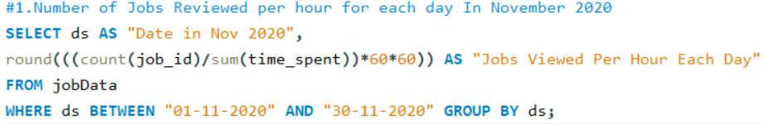
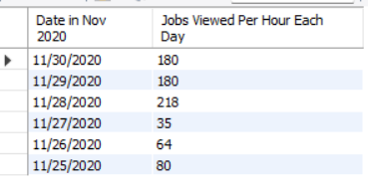
RESULT:CASE STUDY-1
Job Data Analysis
Task 1: Jobs Reviewed Over Time
Queries:
Output:

Slide 7
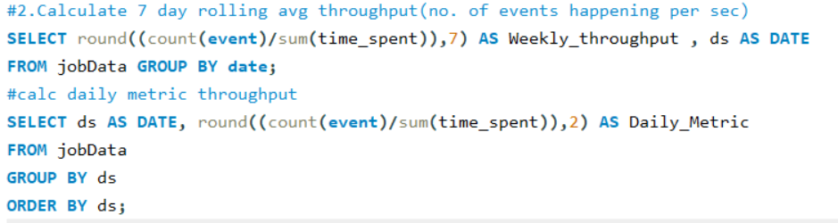
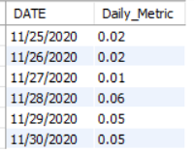
Task 2 - Throughput Analysis:
Queries:
Output:

Slide 8
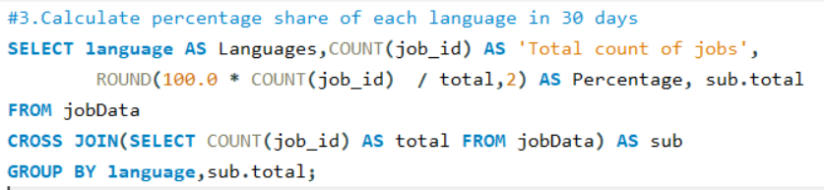
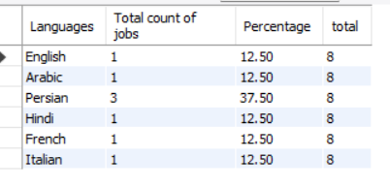
Task 3 - Language Share Analysis:
Queries:
Output:

Slide 9
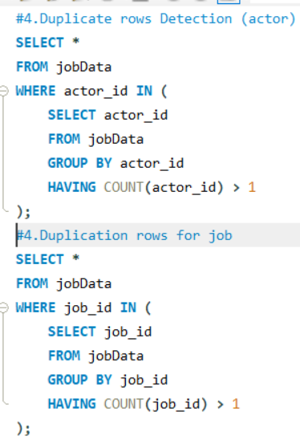


Task 4 -Duplicate Rows Detection:
Queries:
Output:
For Actor:
For Job:

Slide 10
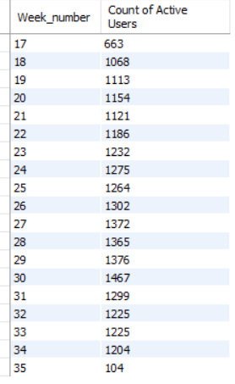
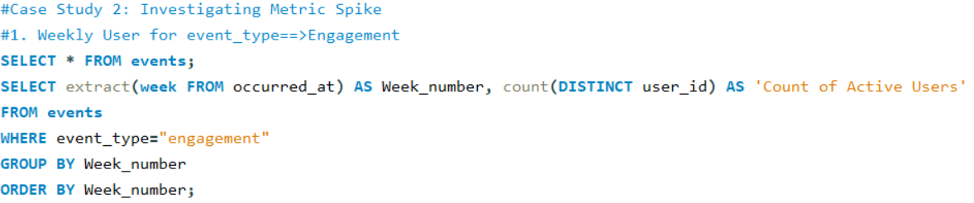
Case Study 2: Investigating Metric Spike
Task 1-Weekly User Engagement:
Output:
Queries:

Slide 11
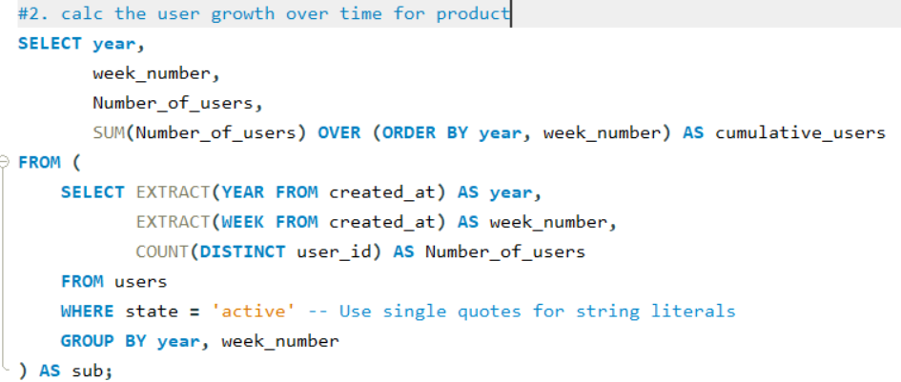
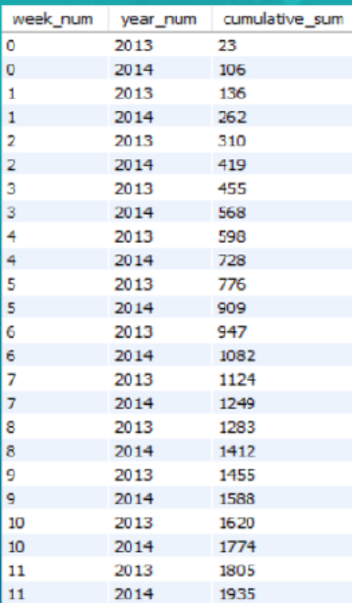
Task 2-User Growth Analysis:
Queries:
Output:

Slide 12
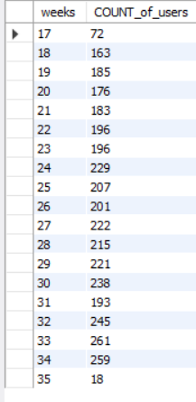
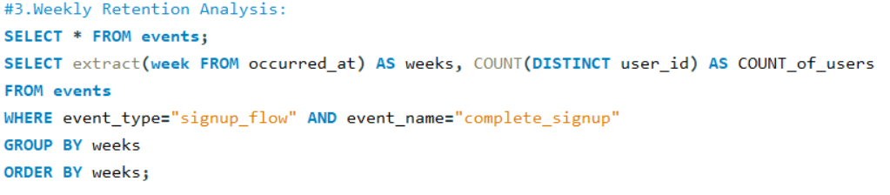
Task 3-Weekly Retention Analysis:
Output:
Queries:

Slide 13
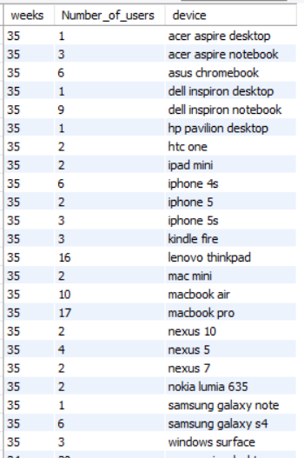
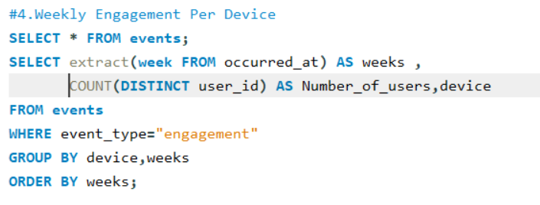
Task 4-Weekly Engagement Per Device:
Output:
Queries:

Slide 14
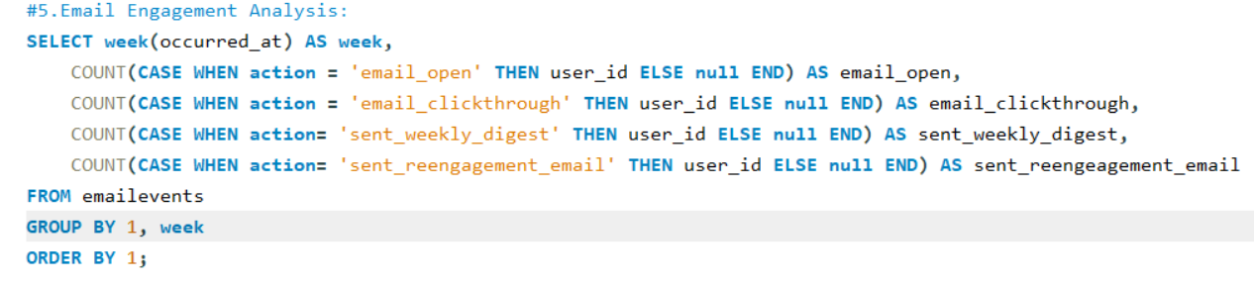
Task 5-Email Engagement Analysis
Queries:
Output:

Slide 15



THANK YOU
Linkedin:
https://www.linkedin.com/in/komal-barhate-18a36225a/n
Email:
komalbarhate2004@gmail.com
GitHub:
https://github.com/BarhateKomal

